Slide 1
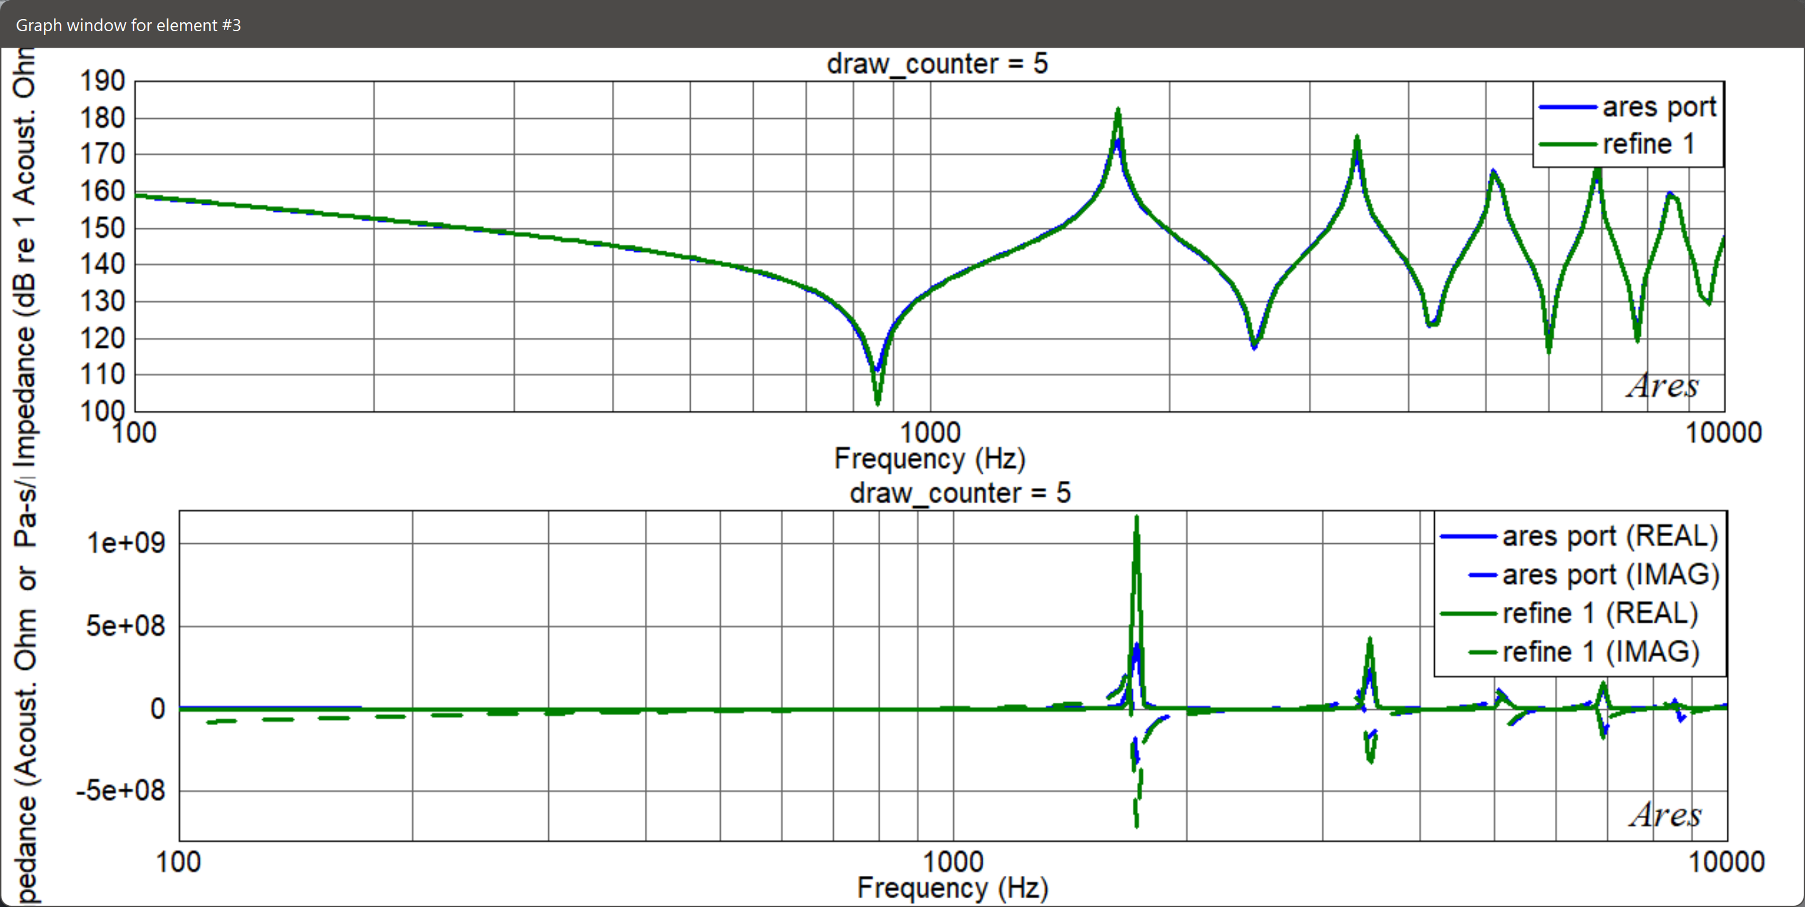
5x5 100mm long sealed rho and B complex

Slide 2
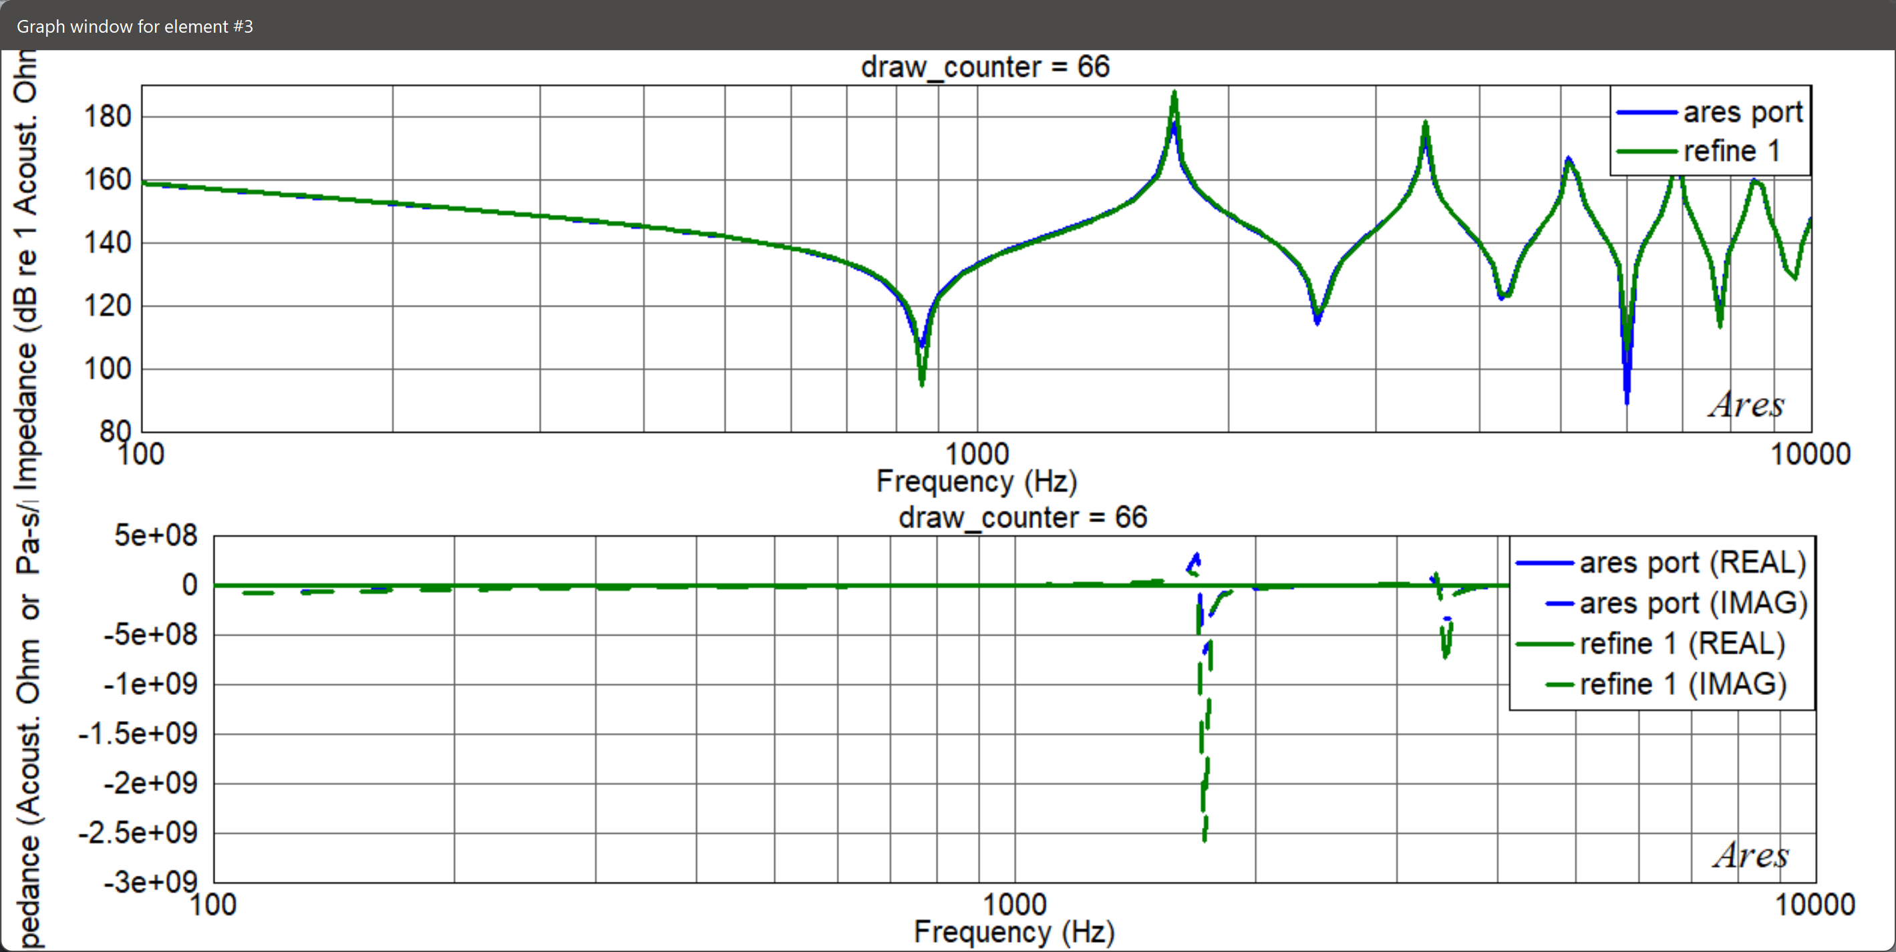
5x5 100mm long sealed imaginary parts of rho and B set to zero

Slide 3
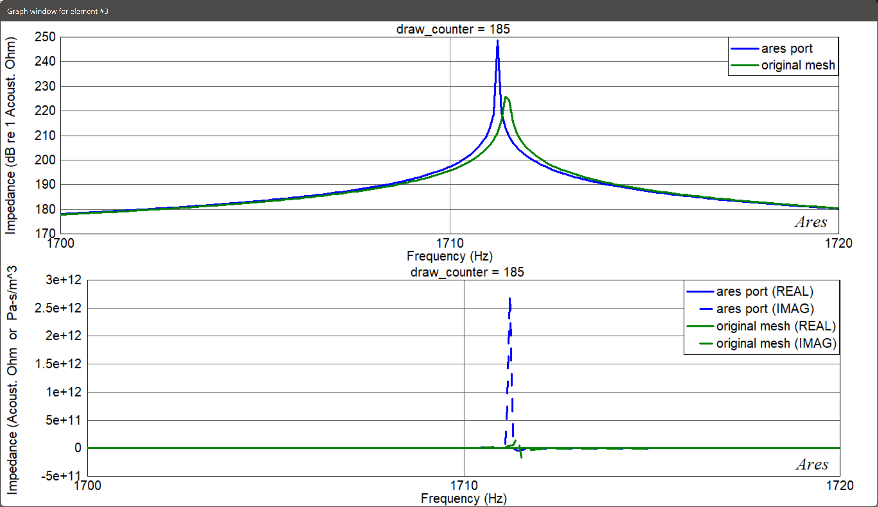
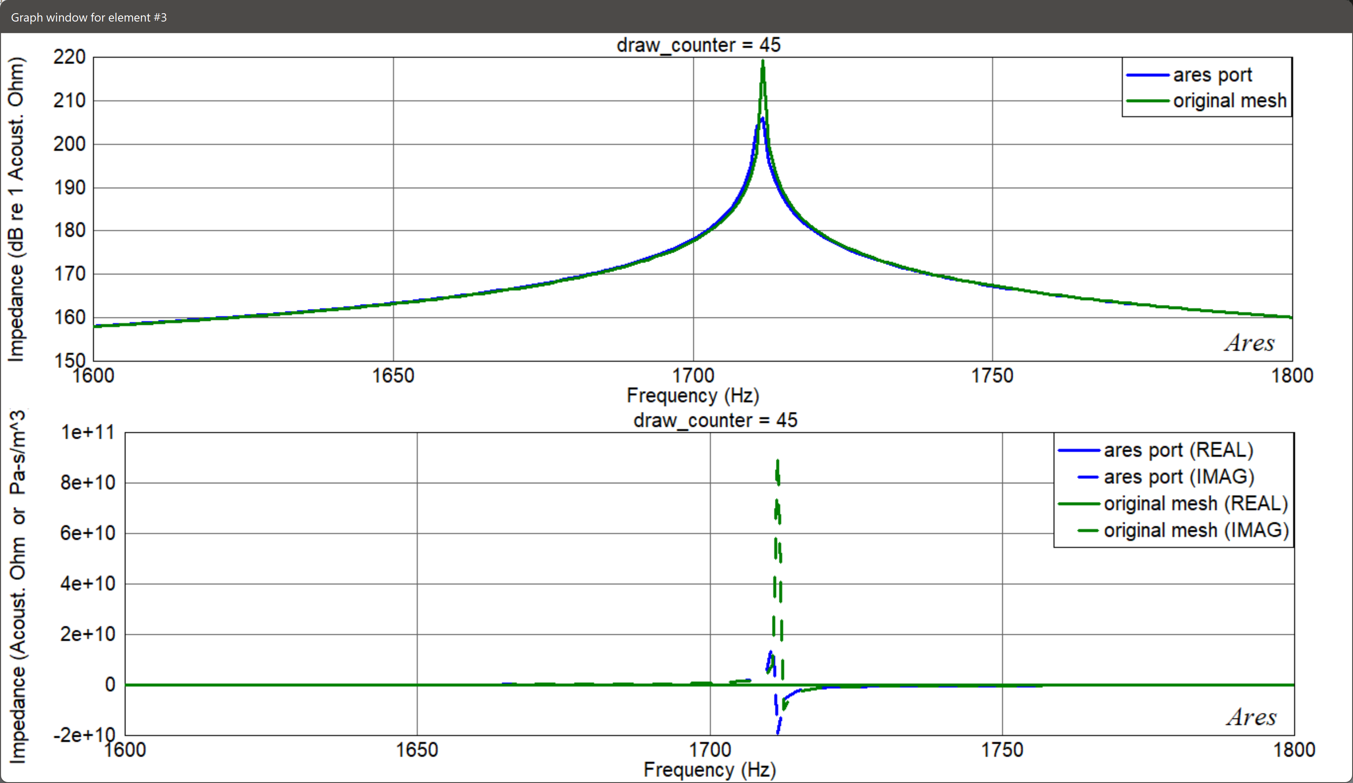
5x5 100mm long sealed imaginary parts of rho and B set to zero
high resolution around 1710 hz resonance

Slide 4
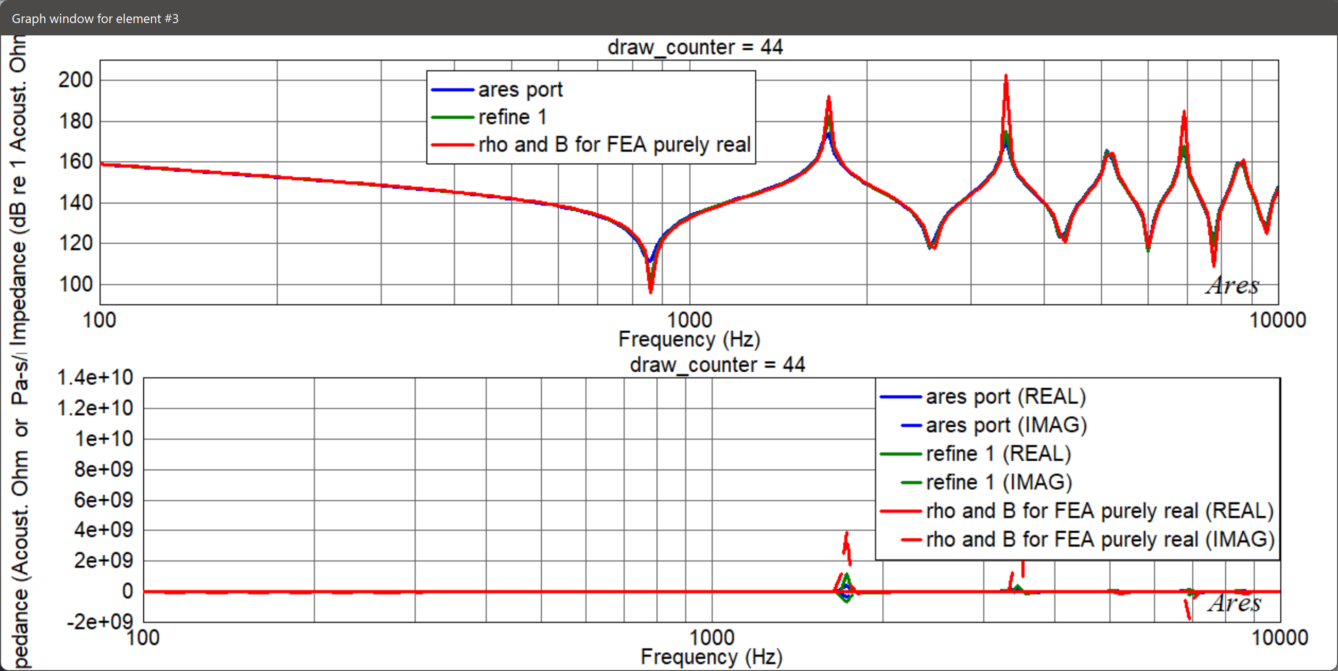
5x5 100mm long sealed comparing rho and B complex to purely real

Slide 5
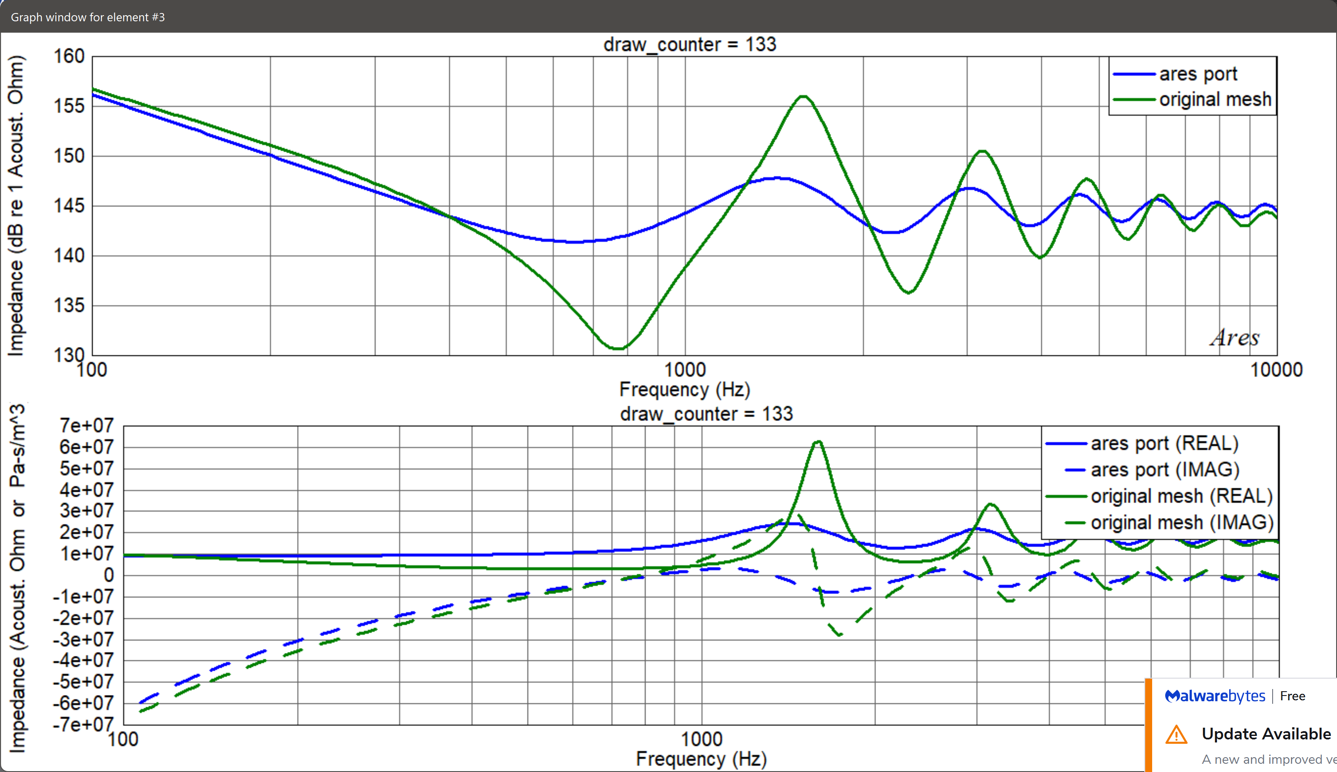
5x5 100mm long sealed rho and B for 0.2mm slot height

Slide 6
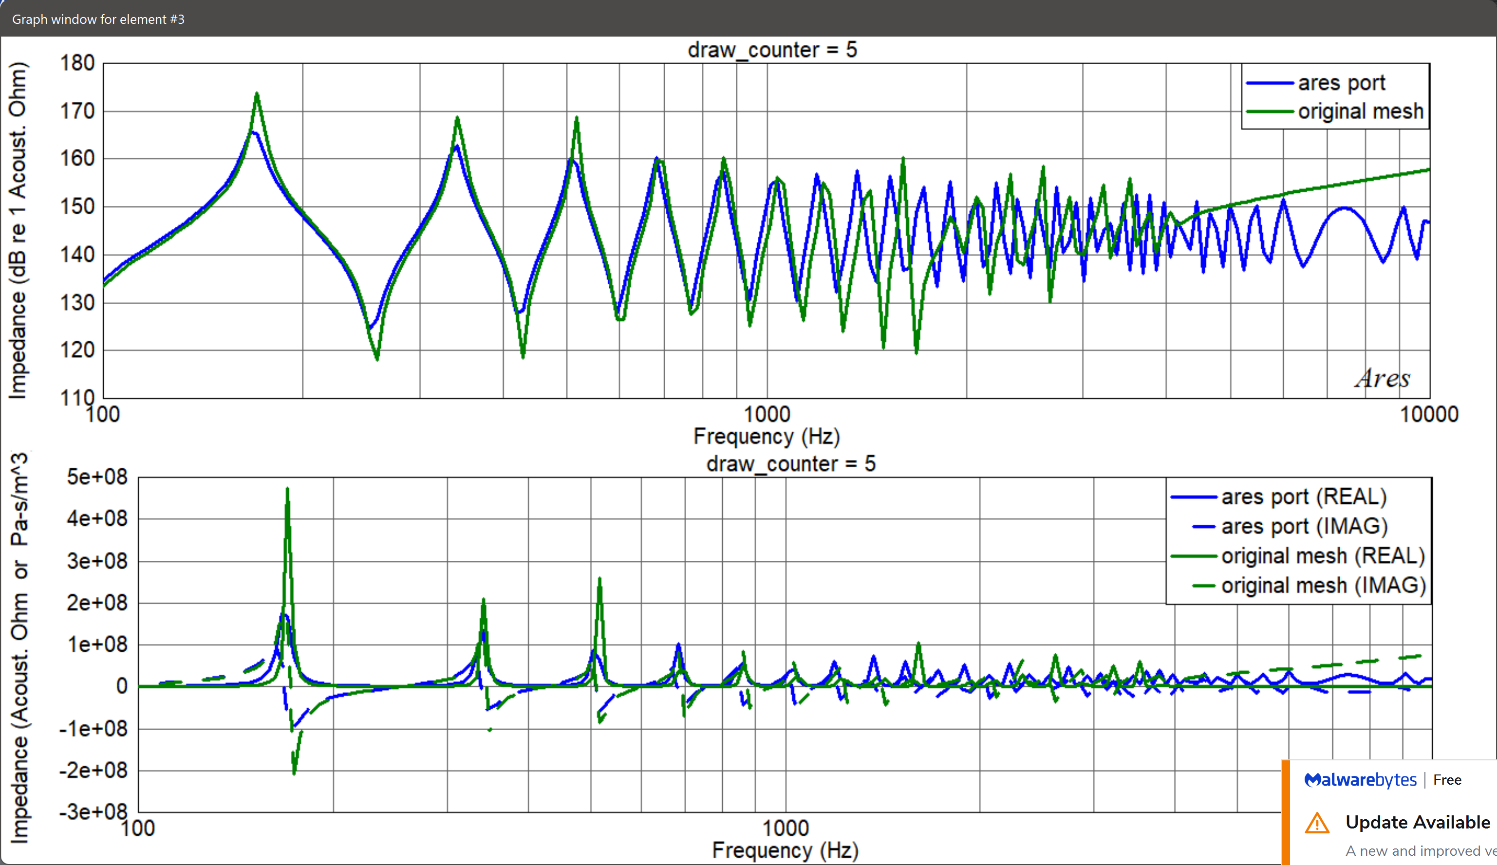
5x5 1m long sealed rho and B complex

Slide 7
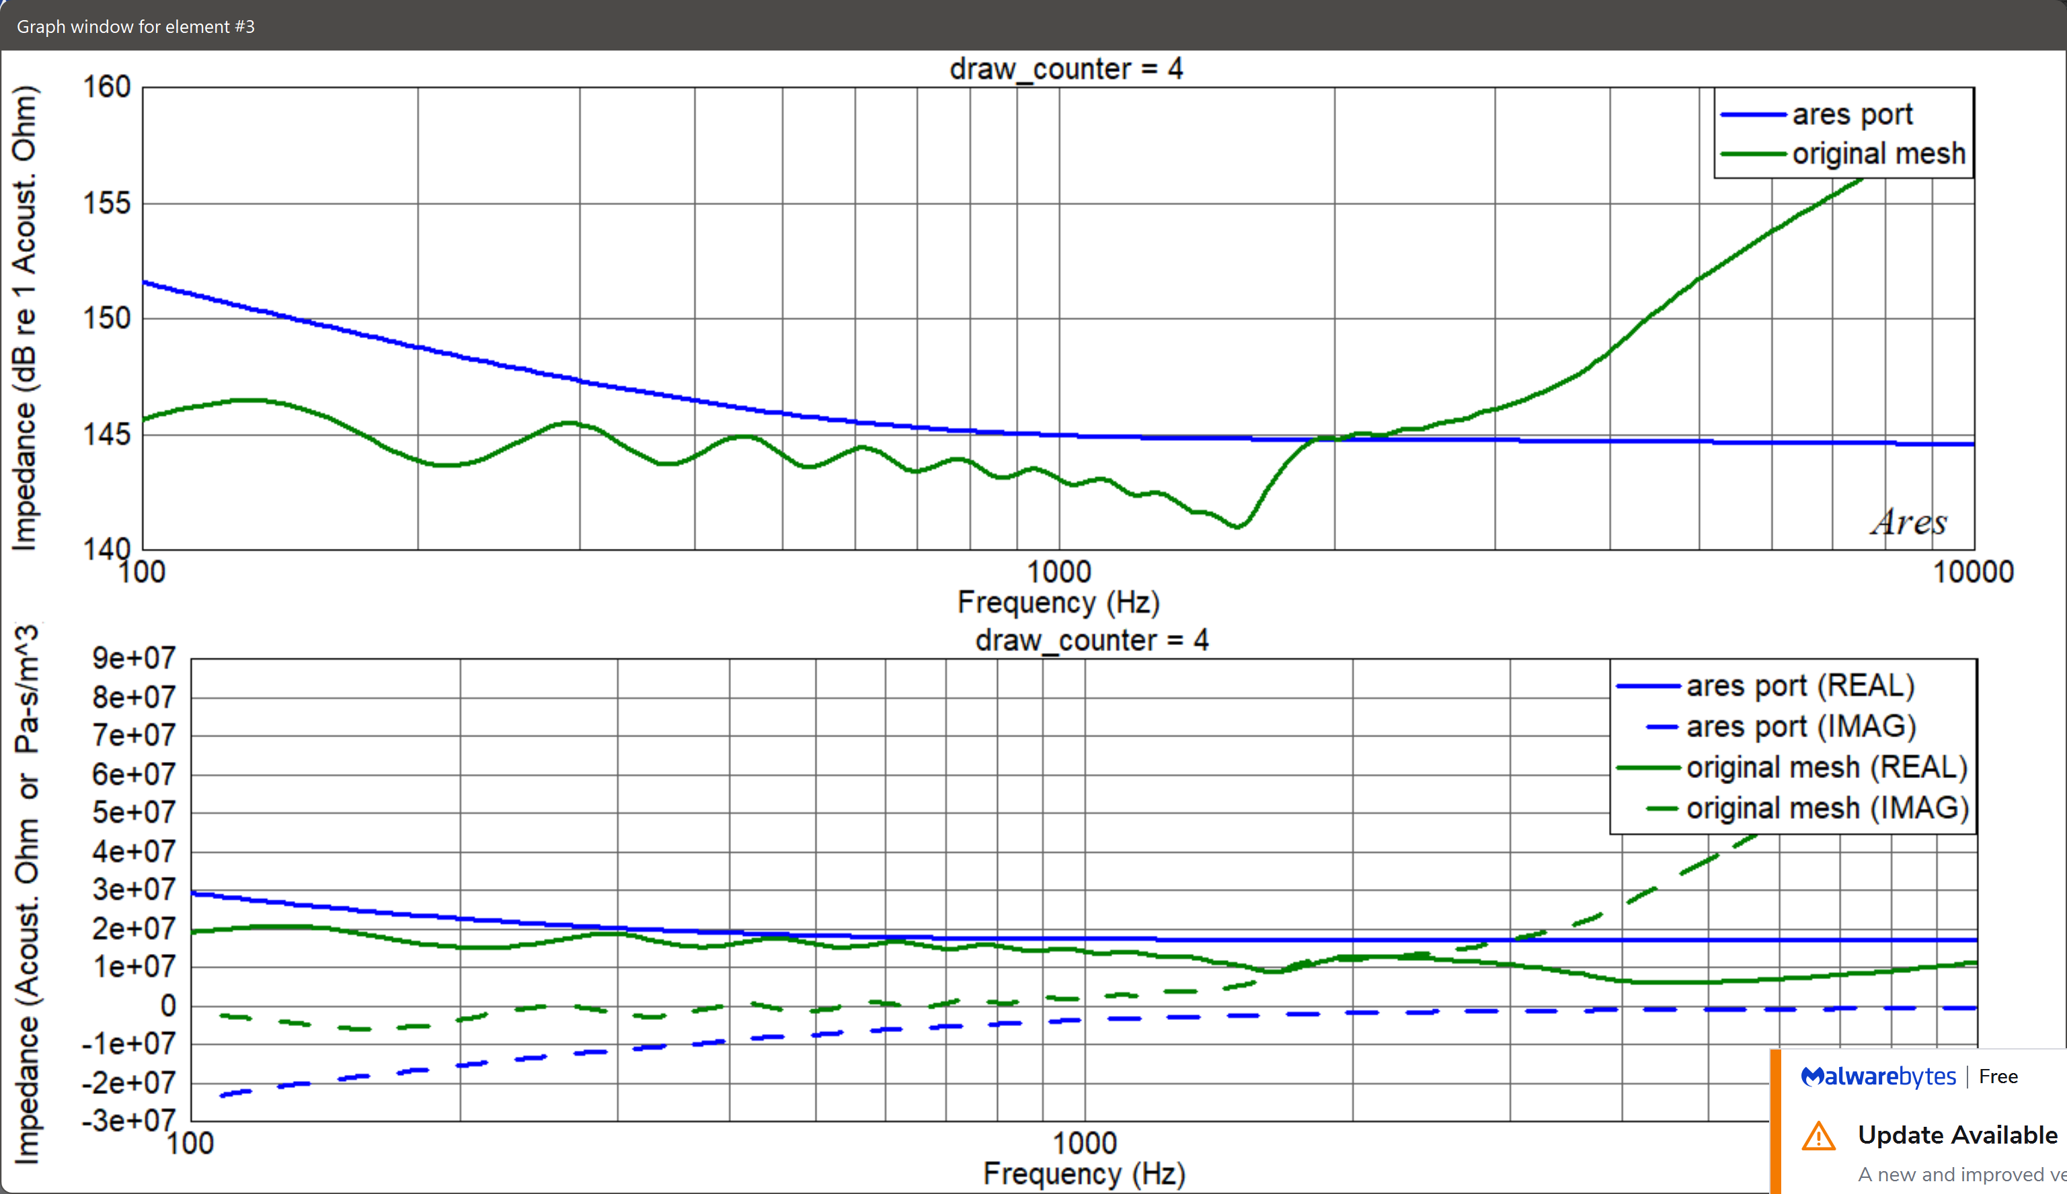
5x5 1m long sealed rho and B for 0.2mm high slot

Slide 8
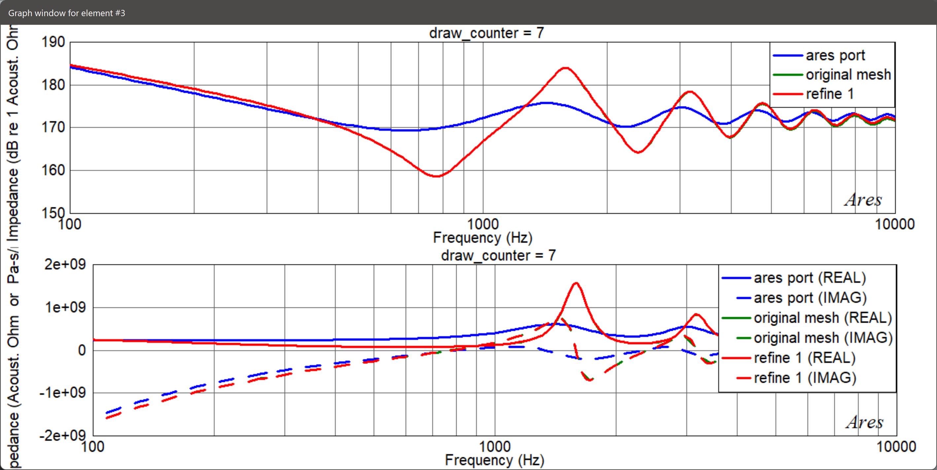
5x0.2 100mm long sealed rho and B complex

Slide 9
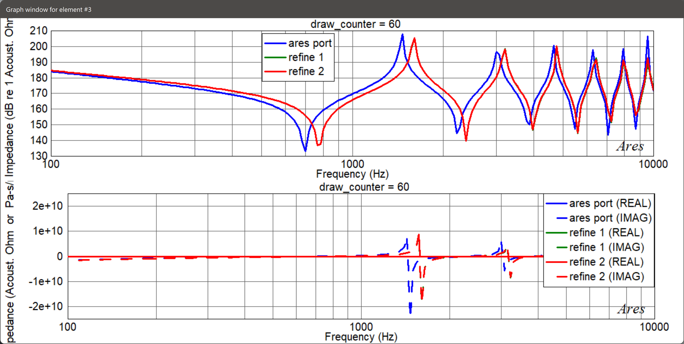
5x0.2 100mm long sealed imaginary parts of rho and B set to zero

Slide 10
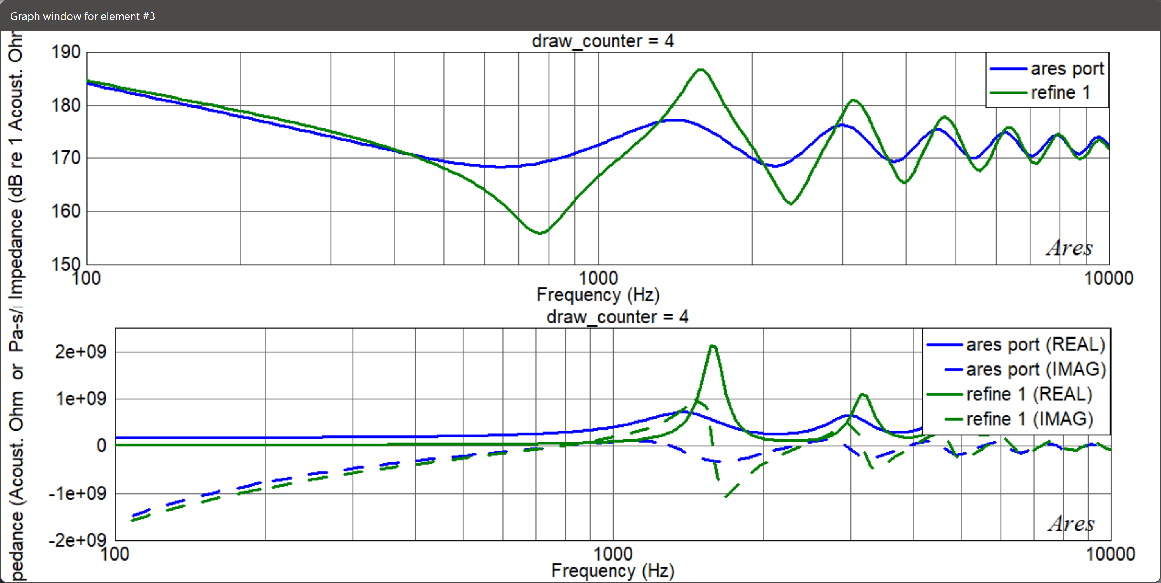
5x0.2 100mm long sealed imaginary part B set to zero

Slide 11
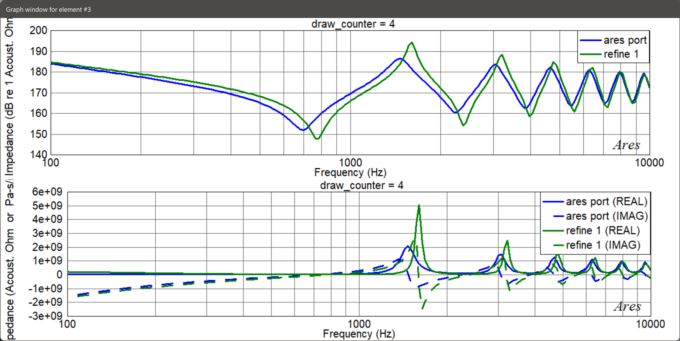
5x0.2 100mm long sealed imaginary part rho set to zero

Slide 12
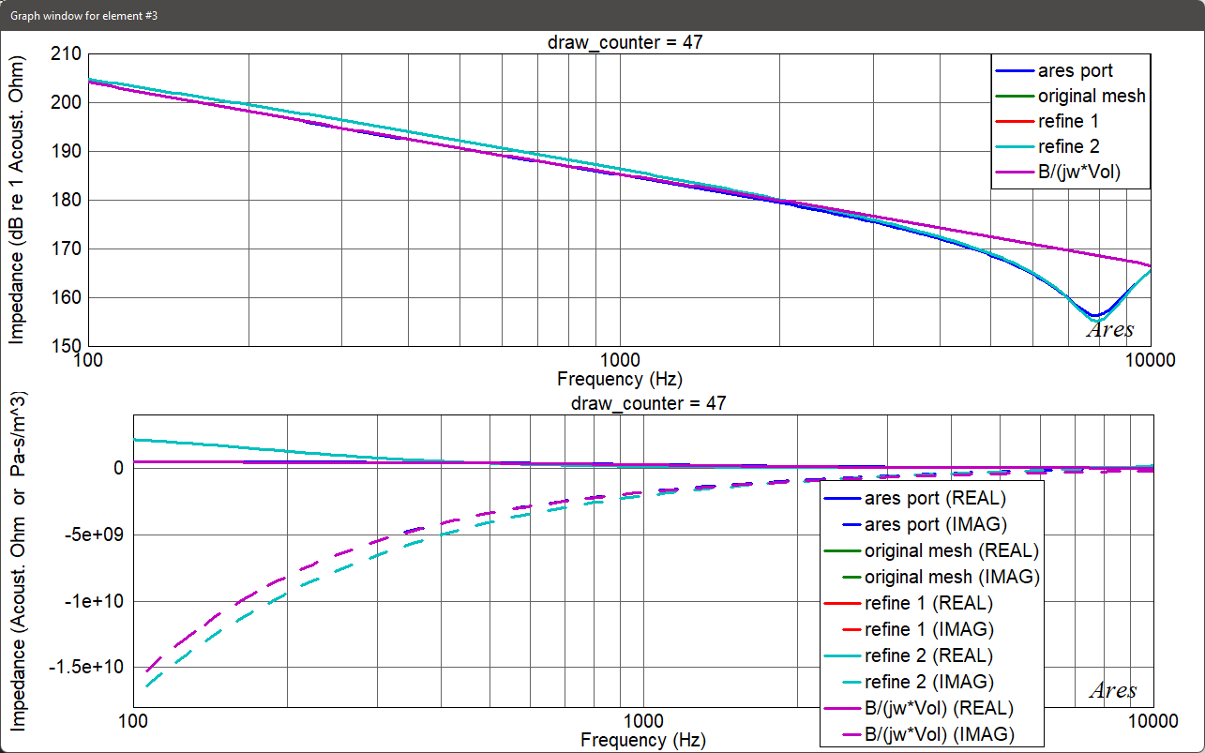
5x0.2 10mm long sealed rho and B complex

Slide 13
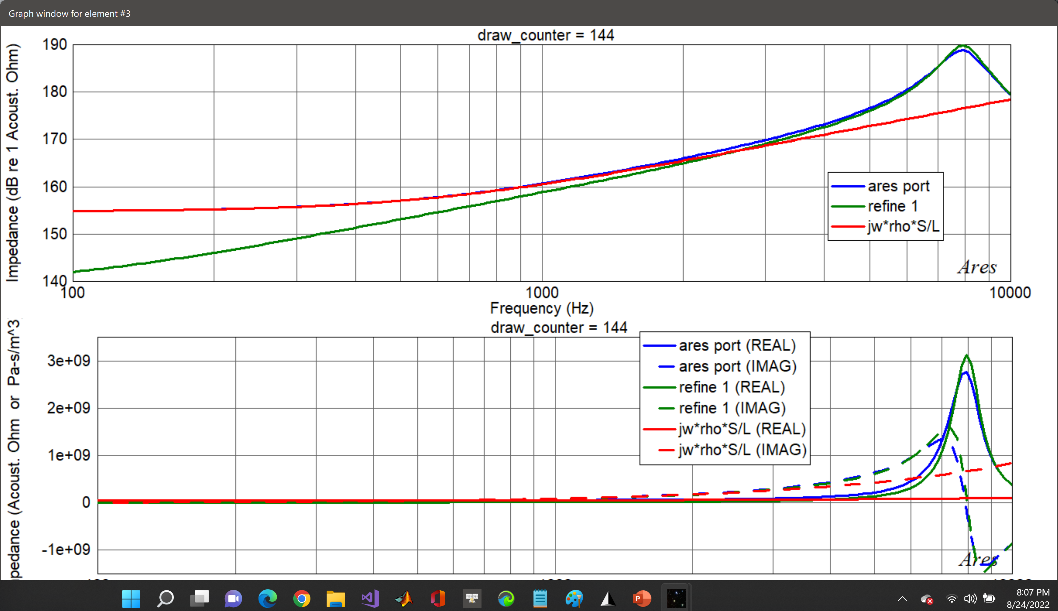
5x0.2 10mm long P=0 termination rho and B complex
L/S
L/S
L/S

Slide 14
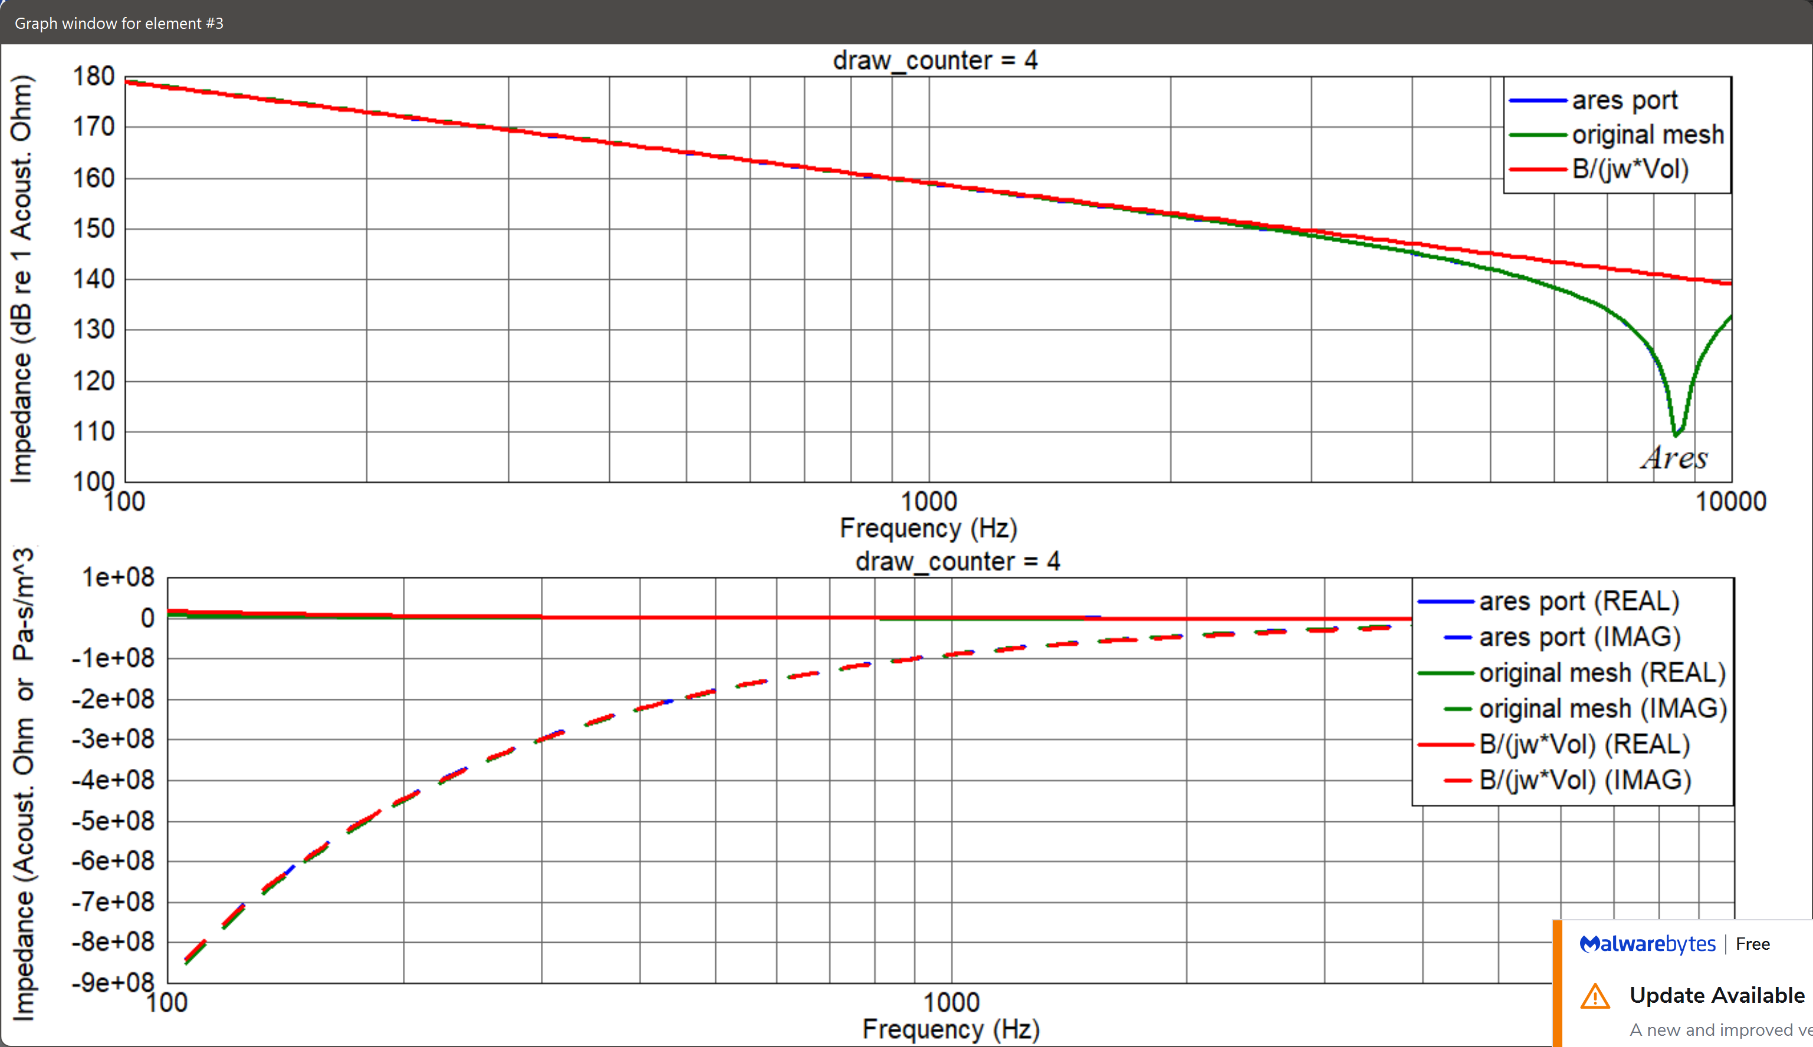
5x5 10mm long sealed rho and B complex

Slide 15
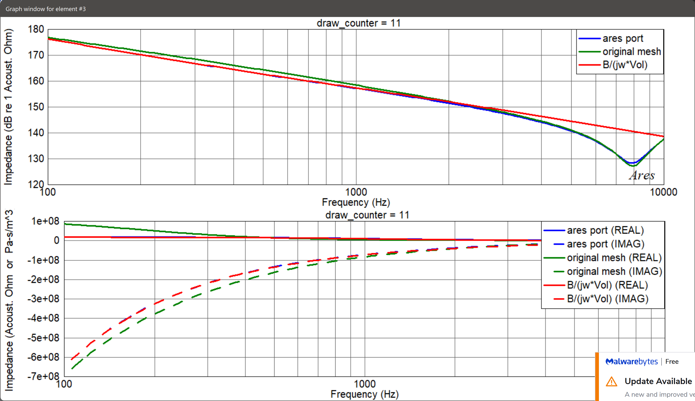
5x5 10mm long sealed rho and B complex for 0.2mm height

Slide 16
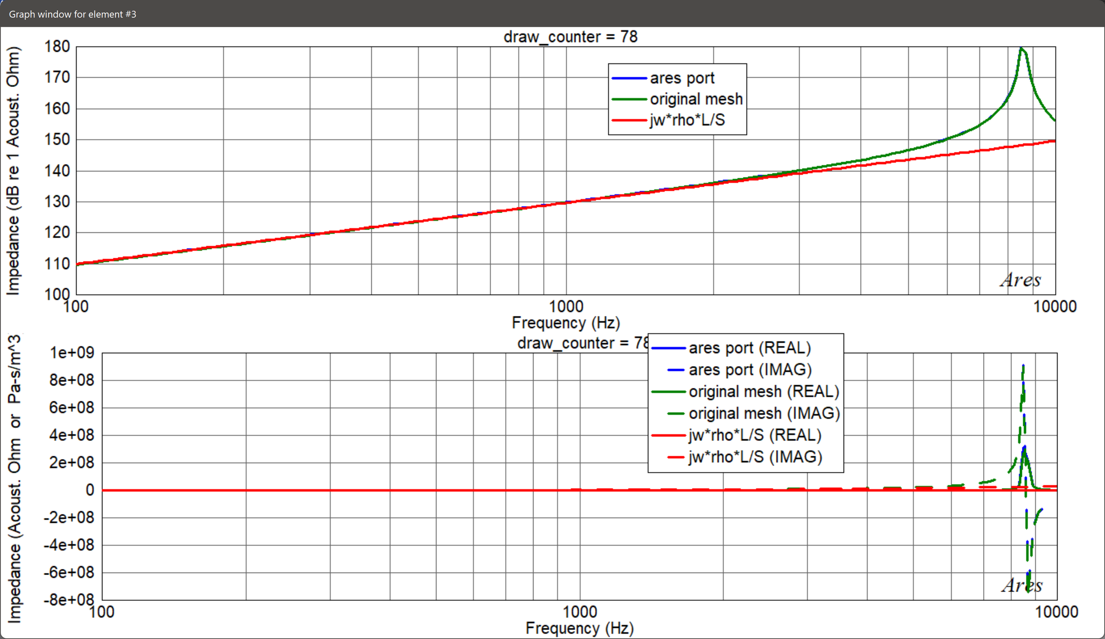
5x5 10mm long P=0 termination rho and B complex

Slide 17
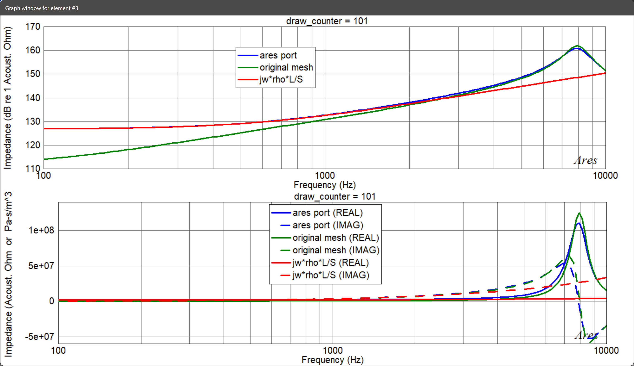
5x5 10mm long P=0 termination rho and B complex for 0.2mm height

